Slide 1

Classification & Logistic Regression & maybe deep learning
?
Slides by:
Joseph E. Gonzalez jegonzal@cs.berkeley.edu

Slide 2
Previously…

Slide 3
Recipe for Successful Generalization
Split your data into training and test sets (90%, 10%)
Use only the training data when designing, training, and tuning the model
Use cross validation to test generalization during this phase
Do not look at the test data
Commit to your final model and train once more using only the training data.
Test the final model using the test data. If accuracy is not acceptable return to (2). (Get more test data if possible.)
Train on all available data and ship it!

Slide 4
Training vs Test Error
Training error typically under estimates test error.
← Underfitting
Overfitting →
Best Fit
Test Error
Error
Training Error
Model “complexity”
(e.g., number of features)

Slide 5
Generalization: The Train-Test Split
Training Data: used to fit model
Test Data: check generalization error
How to split?
Randomly, Temporally, Geo…
Depends on application (usually randomly)
What size? (90%-10%)
Larger training set → more complex models
Larger test set → better estimate of generalization error
Typically between 75%-25% and 90%-10%
Train - Test
Split
Train
Data
Test
You can only use the test dataset once after deciding on the model.

Slide 6
Generalization: Validation Split
Training Data: used to fit model
Test Data: check generalization error
How to split?
Randomly, Temporally, Geo…
Depends on application (usually randomly)
What size? (90%-10%)
Larger training set → more complex models
Larger test set → better estimate of generalization error
Typically between 75%-25% and 90%-10%
V
Train - Test
Split
Validation
Split
Train
Train
V
Train
Train
V
Train
Data
V
Train
Validate Generalization
V
5-Fold
Cross Validation
Test
Cross validation simulates multiple train test-splits on the training data.
You can only use the test dataset once after deciding on the model.

Slide 7
Regularized Loss Minimization
Larger values of λ → more regularization
Confusing!: Scikit-learn uses 𝛼 = 1/λ
Larger values of 𝛼 → less regularization
Regularization Parameter

Slide 8
Different choices of
L⁰ Norm Ball
L¹ Norm Ball
L² Norm Ball
L¹ + L² Norm
^{Elastic Net}
Ideal for Feature Selection but combinatorically difficult to optimize
Encourages Sparse Solutions
Convex!
Spreads weight over features (robust)
does not encourage sparsity
Compromise
Need to tune two regularization parameters

Slide 9
Determining the Optimal 𝜆
Test Error
Optimal Value
Validation Error
(Bias)²
Error
How do we determine 𝜆?
Variance
Increasing 𝜆
Value of 𝜆 determines bias-variance tradeoff
Larger values → more regularization → more bias → less variance
Determined through cross validation

Slide 10
Using Scikit-Learn for Regularized Regression
import sklearn.linear_model
Confusion Warning: Regularization parameter 𝛼 = 1/λ
larger 𝛼 ➔ less regularization → greater complexity → overfitting
Lasso Regression (L1)
linear_model.Lasso(alpha=3.0)
linear_model.LassoCV() automatically picks 𝛼 by cross-validation
Ridge Regression (L2)
linear_model.Ridge(alpha=3.0)
linear_model.RidgeCV() automatically selects 𝛼 by cross-validation
Elastic Net (L1 + L2)
linear_model.ElasticNet(alpha=3.0, l1_ratio = 2.0)
linear_model.ElasticNetCV() automatically picks 𝛼 by cross-validation

Slide 11
Standardization and the Intercept Term
Height = θ₁ age_in_seconds + θ₂ weight_in_tons
Regularization penalized dimensions equally
Standardization
Ensure that each dimensions has the same scale
centered around zero
Intercept Terms
Typically don’t regularize intercept term
Center y values (e.g., subtract mean)
Small
Large
Standardization
For each dimension k:

Slide 12
Regularization and High-Dimensional Data
Regularization is often used with high-dimensional data
d
d
𝚽
Tall Skinny Matrix
𝚽
High-dimensional sparse matrix
n
n >> d
typically dense
Regularization can help with complex feature transformations
n
d > n
requires regularization
Goal: to determine informative dimensions
Consider L1 (Lasso) Regularization.
Goal: is to make robust predictions
Consider L2 (+L1) Regularization

Slide 13
Today Classification

Slide 14
So far ….
Domain
Squared Loss
Regularization

Slide 15
Classification
Domain
isAlive?
{0,1}
Squared Loss
Regularization

Slide 16
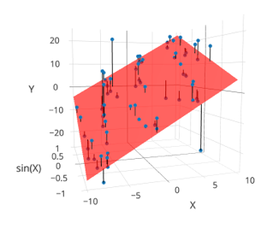
Taxonomy of Machine Learning
Labeled Data
Reward
Unlabeled Data
Supervised Learning
Reinforcement
Learning
(not covered)
Unsupervised
Learning
Quantitative Response
Categorical Response
Dimensionality Reduction
Clustering
Regression
Classification
Alpha Go

Slide 17
Kinds of Classification
Predicting a categorical variable
Binary classification: Two classes
Examples: Spam/Not Spam, churn/stay
Multiclass classification: Many classes (>2)
Examples: Image labeling (Cat, Dog, Car), Next word in a sentence …
Structured prediction tasks (Classification)
Multiple related predictions
Examples: Translation, Voice recognition

Slide 18
Classification
Domain
isAlive?
{0,1}
Can we just use least squares?
Squared Loss

Slide 19
Python Demo
Notes:
Skip zero-one loss cross-validation

Slide 20
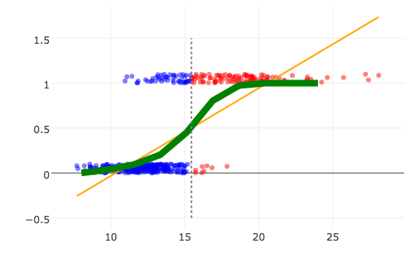
Classification
Domain
isCat?
{0,1}
Can we just use least squares?

Slide 21
Classification
Domain
isCat?
{0,1}
Can we just use least squares?
Yes …
Need a decision function (e.g., f(x) > 0.5) …
Difficult to interpret model …
Sensitive to outliers
Don’t use Least Squares for Classification

Slide 22
Defining a New Model for Classification

Slide 23
Logistic Regression
Widely used models for binary classification:
Models the probability of y=1 given x
“Get a FREE sample ...”
1 = ”Spam”
0 = “Ham”
Why is ham good and spam bad? … (https://www.youtube.com/watch?v=anwy2MPT5RE )
Notes:
X : body of emails in text
Phi(x): encoding of text.
Y: label spam/ham

Slide 24
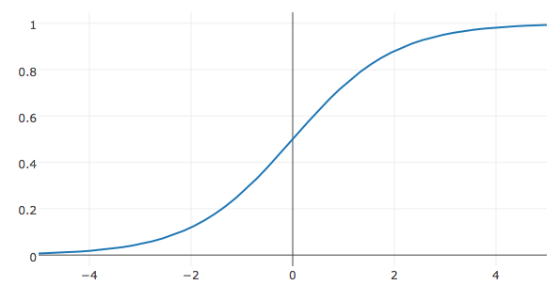
Logistic Regression
Linear Model
Model:
Generalized Linear Model:
Non-linear transformation of a linear model.

Slide 25
Logistic Regression
Widely used models for binary classification:
Models the probability of y=1 given x
“Get a FREE sample ...”
1 = ”Spam”
0 = “Ham”
Why is ham good and spam bad? … (https://www.youtube.com/watch?v=anwy2MPT5RE )

Slide 26
Python Demo
Visualizing the sigmoid (Part 2 notebook)

Slide 27
The Logistic Regression Model
Model:
How do we fit the model to the data?

Slide 28
Defining the Loss

Slide 29
Could we use the Squared Loss
What about squared loss and the new model:
Tries to match probability with 0/1 labels.
Occasionally used in some neural network applications
Non-convex!

Slide 30
Could we use the Squared Loss
What about squared loss and the new model:
Tries to match probability with 0/1 labels.
Occasionally used in some neural network applications
Non-convex!
Toy data
Squared Loss Surface

Slide 31
Defining the Cross Entropy Loss

Slide 32
Loss Function
We want our model to be close to the data:
Kullback–Leibler (KL) Divergence provides a measure of similarity between two distributions:
Between two discrete distributions P and Q

Slide 33
Kullback–Leibler (KL) Divergence
The average log difference between P and Q weighted by P
Does not penalize mismatch for rare events with respect to P

Slide 34
Loss Function
We want our model to be close to the data:
Kullback–Leibler (KL) divergence for classification
For a single (x,y) data point
Average KL Divergence for all the data:
=2
Binary Classification

Slide 35
Loss Function
We want our model to be close to the data:
Kullback–Leibler (KL) divergence for classification
For a single (x,y) data point
Average KL Divergence for all the data:
=2
Binary Classification
Log(a/b) = Log(a) – Log(b)
Doesn’t depend on θ

Slide 36
Loss Function
We want our model to be close to the data:
Kullback–Leibler (KL) divergence for classification
For a single (x,y)
Average cross entropy loss
Summing from k = 0 to 1 and not k = 1 to 2 (to be consistent with 0/1 labels):

Slide 37
Loss Function
We want our model to be close to the data:
Kullback–Leibler (KL) divergence for classification
For a single (x,y)
Average cross entropy loss
=2
Binary Classification
Rewriting on one line:

Slide 38
Loss Function
We want our model to be close to the data:
Kullback–Leibler (KL) divergence for classification
For a single (x,y)
Average cross entropy loss
Expanding
Grouping Terms
Copy & Paste

Slide 39
Definition
Alg.
Alg.
Alg.

Slide 40
Definition
A Linear model of the “Log odds”
Linear Model
Log odds

Slide 41
Definition
A Linear mode of the “Log odds”
Linear Model
Log odds
Implications?

Slide 42
A Linear mode of the “Log odds”
Linear Model
Definition
Log odds
Substituting the above result:
Defn. of σ
Alg.
Alg.

Slide 43
Substituting the above result:
Defn. of σ
Alg.
Alg.
Definition
Defn. of σ
Simplified Loss Minimization Problem

Slide 44
The Loss for Logistic Regression
Average cross entropy (simplified):
Equivalent to (derived from) minimizing the KL divergence
Also equivalent to maximizing the log-likelihood of the data … (not covered in DS100 this semester)
Is this loss function reasonable?

Slide 45
Convexity Using Pictures
Toy data
Squared Loss Surface
KL Div. Loss Surface

Slide 46
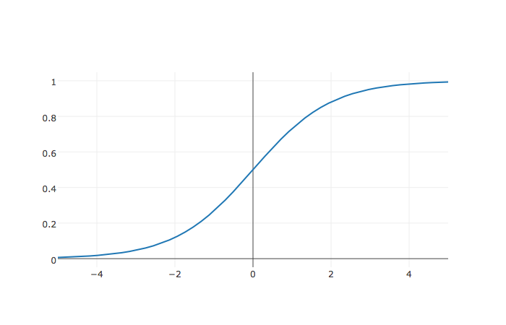
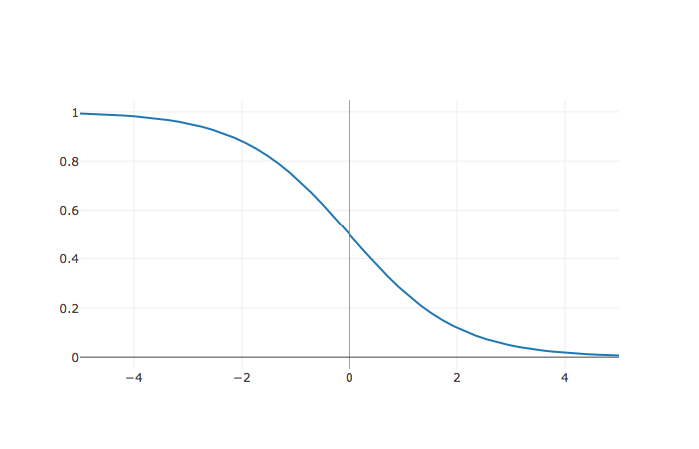
What is the value of θ?
http://bit.ly/ds100-fa18-???
Assume:
The Data
(-1,1)
1
(1,0)
-1
0
1

Slide 47
What is the value of θ?
(-1,1)
Assume:
The Data
1
For the point (-1,1):
(1,0)
Objective:
-1
0
1

Slide 48
What is the value of θ?
For the point (-1,1):
Assume:
For the point (1, 0):
(-1,1)
The Data
1
(1,0)
-1
0
1

Slide 49
What is the value of θ?
For the point (-1,1):
Assume:
Total Loss
For the point (1, 0):
Overly confident!
(-1,1)
1
Degenerate Solution!
The Data
(1,0)
-1
0
1

Slide 50
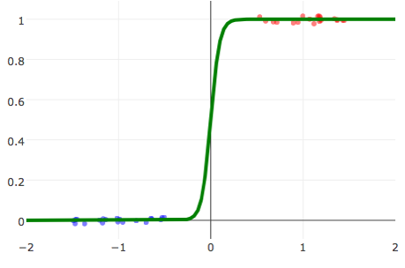
Linearly Separable Data
Linearly Separable Data
A classification dataset is said to be linearly separable if there exists a hyperplane that separates the two classes.
If data is linearly separable, logistic regression requires regularization
Not Linearly Separable Data
Weights go to infinity!
Solution?

Slide 51
Adding Regularization to Logistic Regression
Prevents weights from diverging on linearly separable data
Without Regularization
With Regularization (λ = 0.1)
Earlier Example

Slide 52
Minimize the Loss

Slide 53
Logistic Loss Function
Average KL divergence (simplified)
Take Derivative:

Slide 54
Logistic Loss Function
Average KL divergence (simplified)
Take Derivative:

Slide 55
Logistic Loss Function
Average KL divergence (simplified)
Take Derivative:
Useful Identity
Chain Rule
Chain Rule
Alg.
Defn. of σ
Alg.

Slide 56
Logistic Loss Function
Average KL divergence (simplified)
Take Derivative:
Useful Identity

Slide 57
Logistic Loss Function
Average KL divergence (simplified)
Take Derivative:
Set derivative = 0 and solve for θ
No general analytic solution
Solved using numeric methods

Slide 58
The Gradient Descent Algorithm
initial vector (random, zeros …)
For 𝜏 from 0 to convergence:
Evaluated
at
ρ(𝜏) is the step size (learning rate)
typically 1/𝜏
Converges when gradient is ≈ 0 (or we run out of patience)

Slide 59
Gradient Descent for Logistic Regression
Logistic Regression
initial vector (random, zeros …)
For 𝜏 from 0 to convergence:
ρ(𝜏) is the step size (learning rate)
typically 1/𝜏
Converges when gradient is ≈ 0 (or we run out of patience)
Notes:
= -\frac{1}{n}\sum_{i=1}^n \left(y_i
-\sigma\left(\phi(x_i)^T\theta\right) \right) \phi(x_i)

Slide 60
Stochastic Gradient Descent
For many learning problems the gradient is a sum:
For large n this can be costly
What if we approximated the gradient by looking at a few random points:

Slide 61
Stochastic Gradient Descent
For many learning problems the gradient is a sum:
For large n this can be costly
What if we approximated the gradient by looking at a few random points:
Batch
Size
Random sample of records
This is a reasonable estimator for the gradient
Unbiased …
Often batch size is one! (why is this helpful)
Fast to compute!
A key ingredient in the recent success of deep learning

Slide 62
Stochastic Gradient Descent
initial vector (random, zeros …)
For 𝜏 from 0 to convergence:
Decomposable
Loss
Loss can be written as a sum of the loss on each record.

Slide 63
initial vector (random, zeros …)
For 𝜏 from 0 to convergence:
Gradient Descent
Very Similar Algorithms
initial vector (random, zeros …)
Assuming Decomposable Loss Functions
For 𝜏 from 0 to convergence:
Stochastic Gradient Descent

Slide 64
Python Demo!

Slide 65
Multiclass (more than 2) Classification
One-vs-rest train separate binary classifiers for each class

Slide 66
Multiclass (more than 2) Classification
One-vs-rest train separate binary classifiers for each class

Slide 67
Multiclass (more than 2) Classification
One-vs-rest train separate binary classifiers for each class

Slide 68
Multiclass (more than 2) Classification
One-vs-rest train separate binary classifiers for each class

Slide 69
Multiclass (more than 2) Classification
One-vs-rest train separate binary classifiers for each class

Slide 70
Multiclass (more than 2) Classification
One-vs-rest train separate binary classifiers for each class
Class with highest confidence wins
Need to address class imbalance issue
Soft-Max multiclass classification

Slide 71
Multiclass (more than 2) Classification
One-vs-rest train separate binary classifiers for each class
Class with highest confidence wins
Need to address class imbalance issue
Soft-Max multiclass classification
Separate for each class
Trained using gradient descent methods
Over parameterized. Why?
k sets of parameters one for each class
Only need k-1 parameters
Often use k parameters + regularization to address “redundancy”.

Slide 72
Python Demo!

Slide 73
Deep Learning
Overview
Bonus Material
Borrowed heavily from excellent talks by:
Adam Coates: http://ai.stanford.edu/~acoates/coates_dltutorial_2013.pptx
Fei-Fei Li and Andrej Karpathy: http://cs231n.stanford.edu/syllabus.html

Slide 74

Logistic Regression as a “Neuron”
Consider the simple function family:
“perceptron”
Neuron “fires” if weighted sum of input is greater than zero.
w₂₃x₂₃
w₅₂x₅₂
w₁₂₃x₁₂₃
Bias= w₀ x

Slide 75

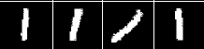
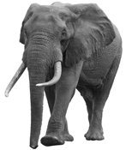

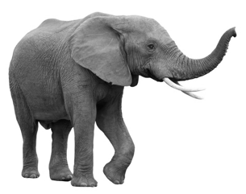
Logistic Regression: Strengths and Limitations
Widely used machine learning technique
convex → efficient to learn
easy to interpret model weights
works well given good features
Limitations:
Restricted to linear relationships → sensitive to choice of features
y = 0
y = 1
0
1
2
Pixel 2
Pixel 2
1
1
0
Pixel 1
Pixel 1

Slide 76
Feature Engineering
0
1
2
Pixel 2
Pixel 2
1
1
0
Pixel 1
Pixel 1
Rather than use raw pixels build/train feature functions:
1
=
1
(Paws, Furry)
Furry
0
0
Paws

Slide 77
Composition Linear Models and Nonlinearities
d
Input Layer
(Pixels)
W⁰
x₁
z
z
h₁
𝜎
k
=
k
k
=
k
h₂
x₂
h_{k}
1
1
1
d
x_{d}
1

Slide 78
Composition Linear Models and Nonlinearities
d
Input Layer
(Pixels)
k
W⁰
x₁
z
z
W¹
z
z
𝜎
h₁
𝜎
h₁
k
k
k
2
=
=
=
2
2
2
h₂
h₂
x₂
k
h_{k}
1
1
1
1
1
1
d
x_{d}
1

Slide 79
Neural Networks
Composing “perceptrons”
W⁰
W¹
x₁
W²
x₂
f
Input Layer
x_{d}
Hidden Layers

Slide 80
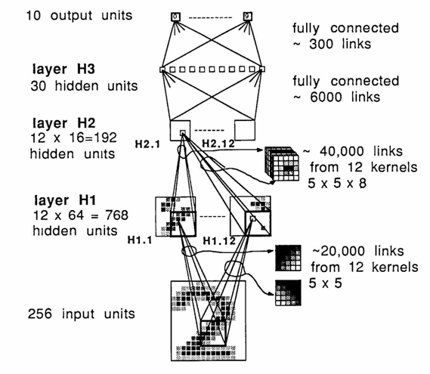
Deep Learning →Many hidden layers …
Output
Output
Input
Logistic Regression

Slide 81

Convolutional Neural Networks: Exploiting Spatial Sparsity

Slide 82
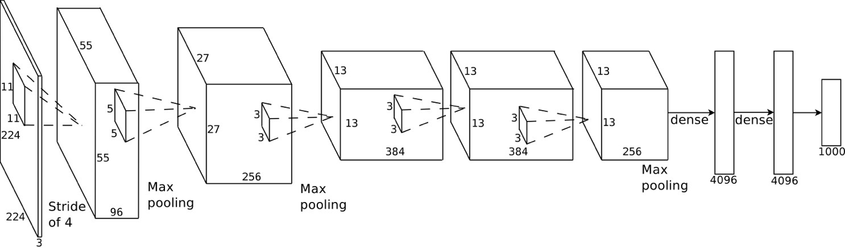
Example: AlexNet (Krizhevsky et al., NIPS 2012)
Introduced in 2012, significantly outperformed state-of-the-art (top 5 error of 16% compared to runner-up with 26% error)

Slide 83
Improvement on ImageNet Benchmark
Super Human

Slide 84
Recurrent Neural Networks: Modeling Sequence Structure
El gato en el sombrero
The cat in the hat.
input + previous output → new output
State of the art in modeling sequential data
speech recognition and machine translation

Slide 85
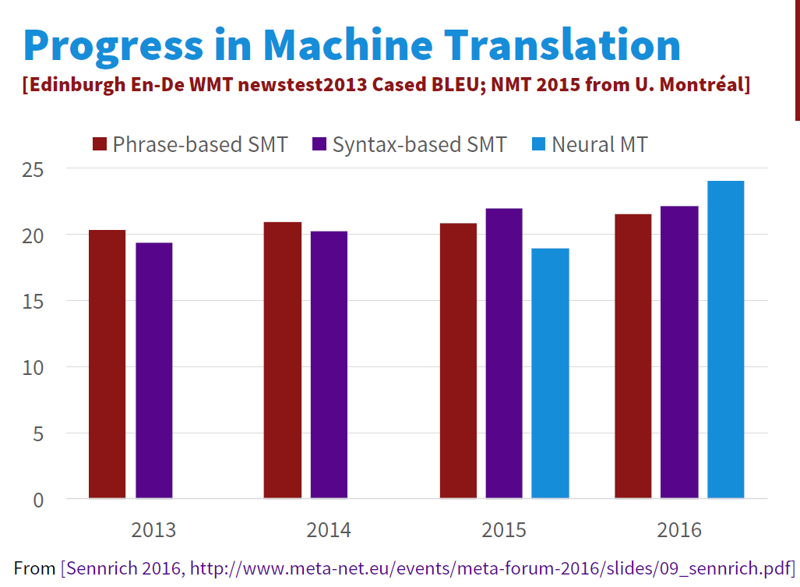
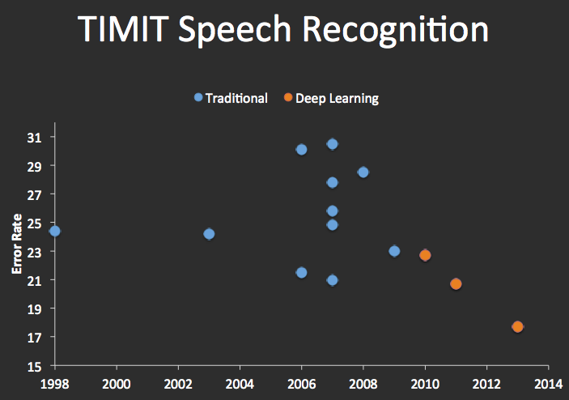
Improvements in Machine Translation & Automatic Speech Recognition

Slide 86
State of the art in Text to Speech (TTS)

Slide 87
Interested in Deep Learning?
RISE Lab Deep Learning Overview:
https://ucbrise.github.io/cs294-rise-fa16/deep_learning.html
TensorFlow Python Tutorial
Stanford CS231 Labs
http://cs231n.github.io/linear-classify/
http://cs231n.github.io/optimization-1/
http://cs231n.github.io/optimization-2/

